Slide 1
Assembly Language: Recursion.
Group Members:
Matata Marvin – 96990
Malik Mohamed - 092852
Omondi Aubrey - 101907

Slide 2
Introduction and Definition
Recursion can be defined as a method of solving a problem where the solution depends on solutions to smaller instances of the same problem.
It can be explained as the act of allowing a function to call itself from within the source code with the intention of solving a problem.
It is an alternative for features and methods such as:
Loops – while and for loops.
Iterations - a process wherein a set of instructions or structures are repeated in a sequence a specified number of times or until a condition is met.
Recursive function - A procedure or subroutine that references itself.

Slide 3
How a particular problem is solved using recursion.
The idea is to represent a problem in terms of one or more smaller problems, and add one or more base conditions that stop the recursion.
For example, we compute factorial n if we know factorial of (n-1). The base case for factorial would be n = 0. We return 1 when n = 0.
Base case is provided and the solution of the bigger problem is expressed in terms of smaller problems.

Slide 4
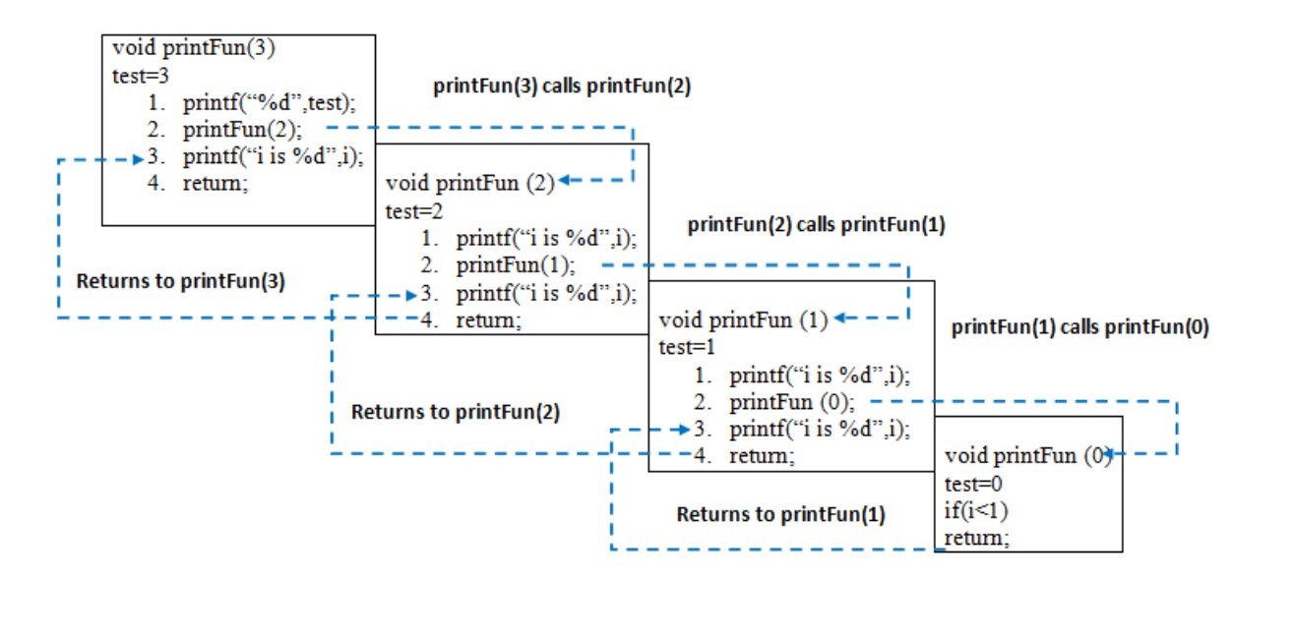
Example of Recursion

Slide 5
Registers used in recursion
During the recursion process, local variables and used registers are placed into stack explicitly and the registers return the result of the problem.
The main registers used are the eax register and the ebx register.
Eax = return value
Ebx = declare parameter
A link register is used to store the return address from a subroutine. This happens by storing the address of the stack and therefore the return address

Slide 6
Recursive data types.
Many computer programs must process or generate an arbitrarily large quantity of data.
Recursion is one technique for representing data whose exact size the programmer does not know: the programmer can specify this data with a self-referential definition.
A self-referential definition is a definition that occurs in natural or formal languages when a sentence, idea or formula refers to itself.

Slide 7
Recursive data types.
Types of recursive data types include:
Inductive definitions - one that specifies how to construct instances of the data.
Coinductive definitions - one that specifies the operations that may be performed on a piece of data.

Slide 8
Inductive data definitions.
An inductively defined recursive data definition is one that specifies how to construct instances of the data.
Example of Inductive data definitions: Linked lists.
Linked lists - linear collection of data elements, whose order is not given by their physical placement in memory. Instead, each element points to the next.

Slide 9
Coinductive data definitions.
A coinductive data definition is one that specifies the operations that may be performed on a piece of data; typically, self-referential coinductive definitions are used for data structures of infinite size.
A coinductive data definition example: Stream of strings.
A stream of strings be defined using a variable ‘s’ whereby:
Head(s) = string
Tail(s) = stream of string.

Slide 10
Coinductive data definitions.
This is very similar to an inductive definition of lists of strings; the difference is that this definition specifies how to access the contents of the data structure
This is through a accessor functions head and tail—and what those contents may be, whereas the inductive definition specifies how to create the structure and what it may be created from.

Slide 11
Difference between inductively defined and coinductive definitions.
Inductively defined data follows a common pattern to build up a set of objects incrementally.
For an inductive definition, we can think of the set as starting from the start and iteratively adding elements according to the rules while for a coinductive definition, one can think of the set as starting from the set of all possible objects (even infinite ones), and iterative removing objects that contradict the rules.

Slide 12
Types of recursion
They are four types of recursion and they include:
Direct recursion vs Indirect recursion.
Tailed vs Non-tailed recursion.
Single recursion and multiple recursion.
Structural versus generative recursion.

Slide 13
Direct recursion vs Indirect recursion.
Direct recursion, is one in which a function calls itself.
For example, a function 1 is called direct recursive if it calls the same function 1.
Indirect recursion, which is also called mutual recursion, occurs when a function is called not by itself but by another function that it called. This is either directly or indirectly.
For example, function 1 calls function 2, function 2 calls function 3, and function 3 calls function 1 again.

Slide 14
Example of Direct recursion
section .text
factorial:
cmp ebx, 1 ; if param = 1, return 1
dec ebx
jnz factorial
mov eax, 1
ret

Slide 15
Example of Indirect Recursion
factorial:
cmp ebx 1 ; if param = 1, return 1
jnz fact1
ldi eax 1
ret
fact1: ; else
push ebx ; save param
dec ebx ; recursive call with param -1
call factorial ; after this, factorial(param -1) in eax
pop ebx ; restore call parameter of this round
mul eax, ebx ; retval = param * factorial(param - 1)
ret ; return retval

Slide 16
Tailed vs Non-tailed recursion.
A recursive function is tail recursive when recursive call is the last thing executed by the function.
In a non-tailed recursion, the recursive call is not the last thing to be executed. This means there’s more code to be executed after the recursive call.
A tailed recursive call is more efficient than a non-tailed one, since the recursive call is the last statement, there is nothing left to do in the current function, so saving the current function’s stack frame is of no use. Hence can be optimized by the compiler.

Slide 17
Single recursion and multiple recursion
Recursion that only contains a single self-reference is known as single recursion, while recursion that contains multiple self-references is known as multiple recursion.
Standard examples of single recursion include list traversal, such as in a linear search, or computing the factorial function.
Standard examples of multiple recursion include tree traversal, such as in a depth-first search, or computing the Fibonacci sequence.

Slide 18
Structural versus generative recursion
In structural recursion, the argument to each recursive call is the content of a field of the original input.
Examples include: nearly all tree traversals, including XML processing and binary tree creation.
Generative recursion generates an entirely new piece of data from the given data and recurs on it.
Examples of generative recursion include: GCD , quicksort, binary search, merge sort , Newton’s method, fractals, and adaptive integration.

Slide 19
Recursive programs
They are different types of recursive programs and they include:
Factorial
Greatest common divisor
Towers of Hanoi
Binary search

Slide 20
Factorial
This is where you find the product of all numbers from 1 to that number
Example:
The factorial of the number 6 is calculated by multiplying all numbers from 1 to 6
1*2*3*4*5*6 = 720

Slide 21
Binary Search
Also known as a half-interval search, is an algorithm used in computer science to locate a specified value within an array.
Example:
When you have an array of numbers 1 to 13 and wanted to find the number 9 these are the steps it will follow.
First it will pick the middle most value in the array which is 7 and compare to the number 9 to see if it’s greater than or less than 7. It is greater so it will move to the right side of the array and repeat the same process. Find the middle value and compare if it’s greater than or less than 9. This process is repeated until the number 9 is found.

Slide 22
Greatest Common Divisor
Defined as the largest positive number that can divide to integers without a remainder
In computing one can use the Euclidean algorithm to computer the GCD of integers
Example:
GCD of 12 and 8 is 4

Slide 23
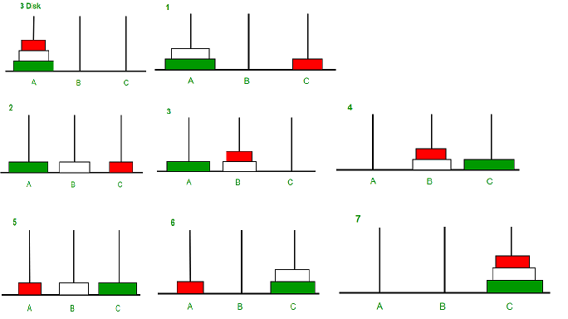
Tower of Hanoi
This is a mathematical puzzle game that consists of three rods and number of disks of different sizes. The objective of the game is to place all the disks on the same rod in order of the smallest at the top and largest at the bottom.

Slide 24
Comparison between Recursion vs Iteration.
Advantages of recursive programming over iterative programming:
Recursion provides a clean and simple way to write code.
Some problems are inherently recursive like tree traversals, Tower of Hanoi, etc. For such problems, it is preferred to write recursive code.

Slide 25
Comparison between Recursion vs Iteration.
Both recursive and iterative programs have the same problem-solving powers , i.e., every recursive program can be written iteratively and vice versa is also true.
Disadvantages of recursive programming over iterative programming:
The recursive program has greater space requirements than iterative program as all functions will remain in the stack until the base case is reached.
It also has greater time requirements because of function calls and returns overhead.

